Slide 1
🔐Encrypted EC2 Backup Automation & Disaster Recovery System (AWS)
📋 Services Used (Free Tier)
EC2-Amazon Elastic Compute Cloud
EBS-Amazon Elastic Block Store
LAMBDA
EVENTBRIDGE
IAM-Identity and Access Management
KMS-Key Management Service (FREE FOR BASIC USE)
CLOUDWATCH
SNS-Amazon Simple Notification Service
Presented by: Heena Kouser
Batch: CLOUD DEVOPS

Slide 2
📘Project Description:
Built an automated encrypted backup and disaster recovery system using AWS Lambda, EBS, KMS, and Event-Bridge. Implemented daily encrypted snapshots, retention policy cleanup, least-privilege IAM roles, and recovery testing to ensure secure data protection and compliance-ready architecture SECURELY.
🎯A system that:
✔ Automatically backs up EC2 EBS volumes ✔ Encrypts backups using customer-managed KMS keys ✔ Locks snapshots against deletion (ransomware protection) ✔ Runs on schedule (no manual work) ✔ Monitors failures & alerts admin

Slide 3
📊 Waterfall SDLC MODEL: (with automation monitoring cloud operations similar to DevOps practices)
🧩 1. Requirement Analysis
📐 2. System Design
⚙ 3. Implementation
🧪 4. Testing
🚀 5. Deployment
🔁 6. Maintenance & Optimization

Slide 4
🏗 Architecture Design:
🧱 Core Components Used:
Layer | AWS Service | Purpose
Compute | EC2 | Application server
Storage | EBS | Primary data volume
Automation | Lambda | Snapshot + encryption
Security | AWS KMS | Encrypt backups
Scheduling | EventBridge | Daily trigger
Monitoring | CloudWatch | Error detection
Alerting | SNS | Email notifications
Recovery | EC2 + EBS | Disaster restore

Slide 5
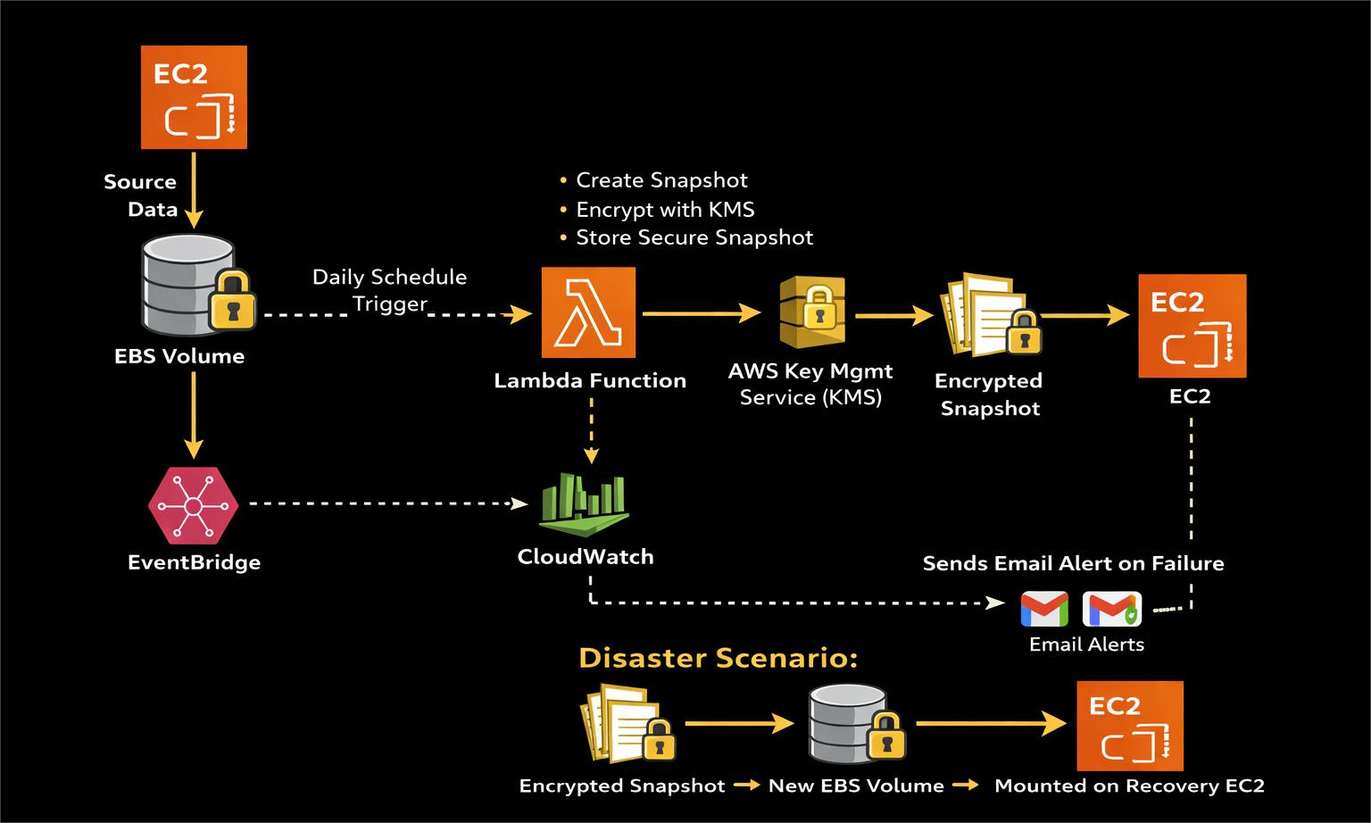
🔄 Architecture Flow :

Slide 6
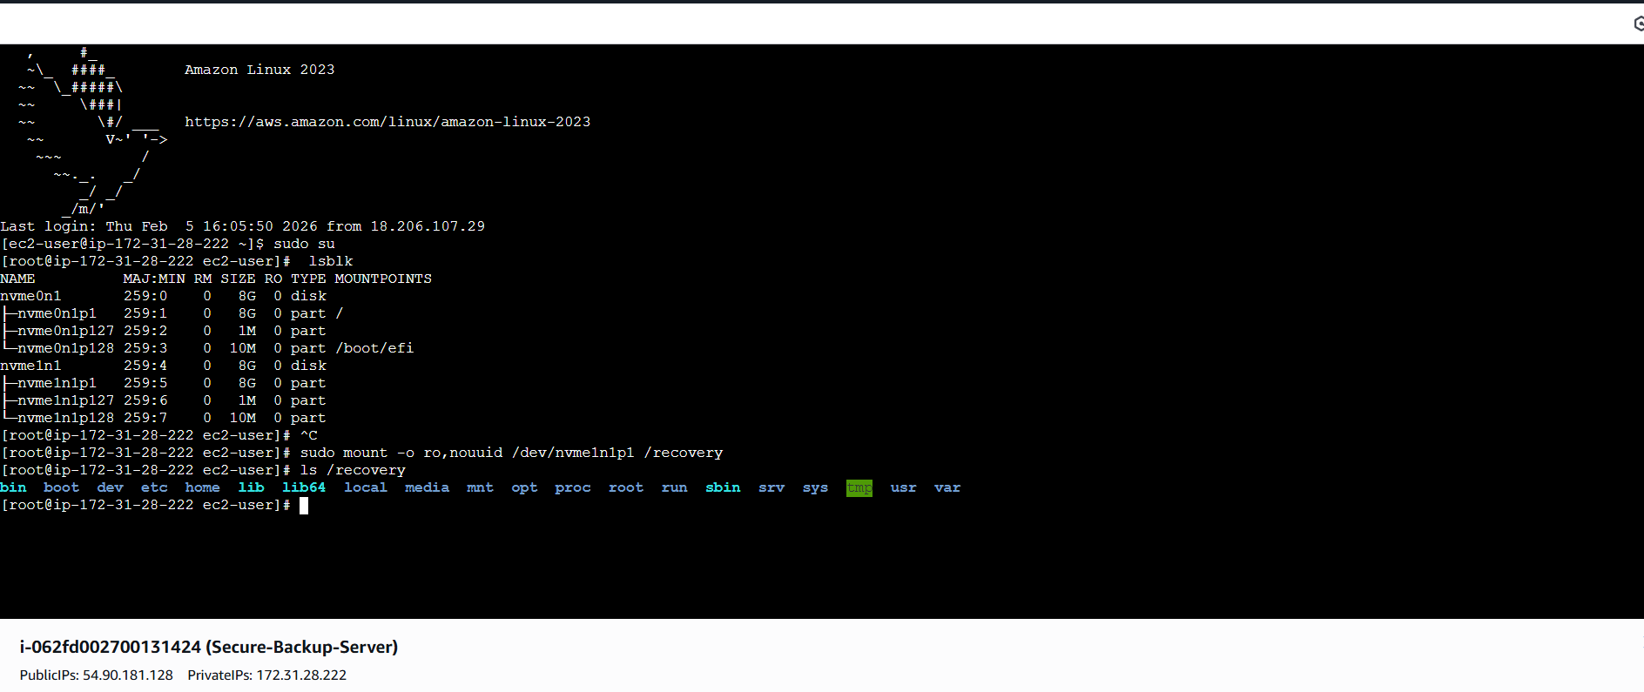
⚡Implementation:

Slide 7
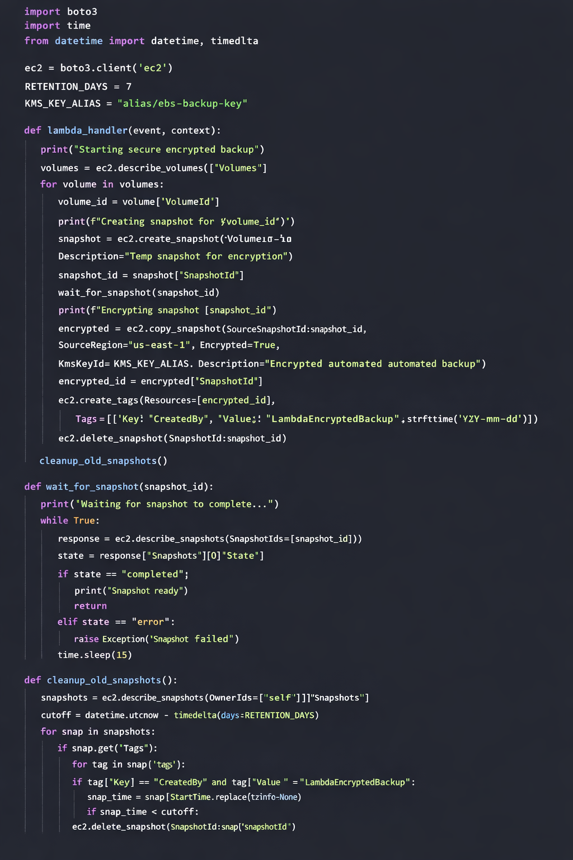
🧠 Lambda CODE:

Slide 8
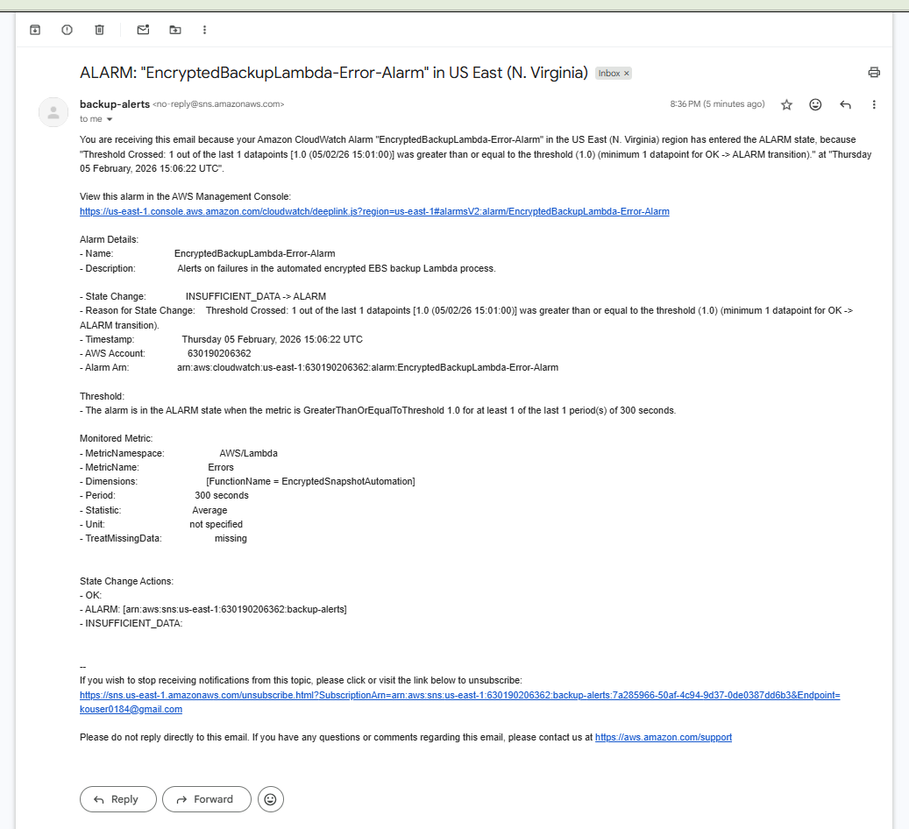
✅Security:
SNS: Amazon Simple Notification Service

Slide 9
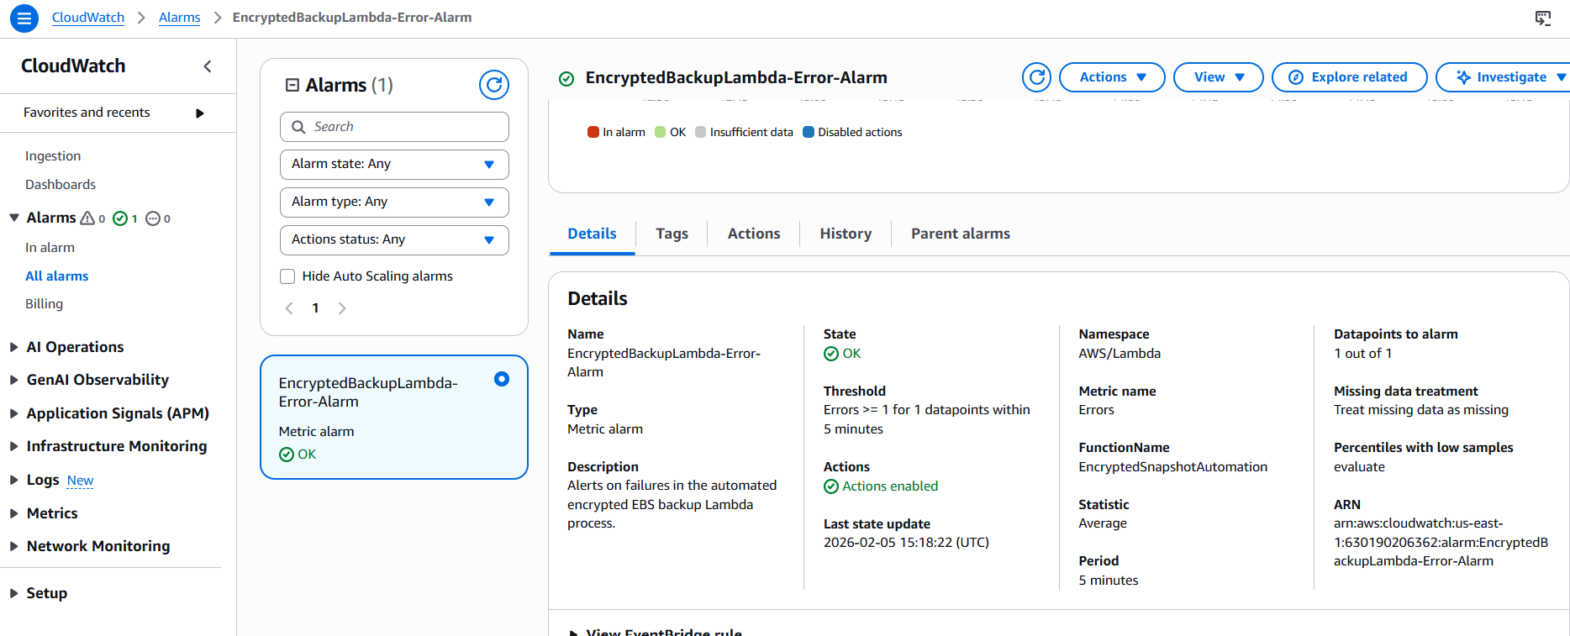
🚨CloudWatch ALARM:

Slide 10
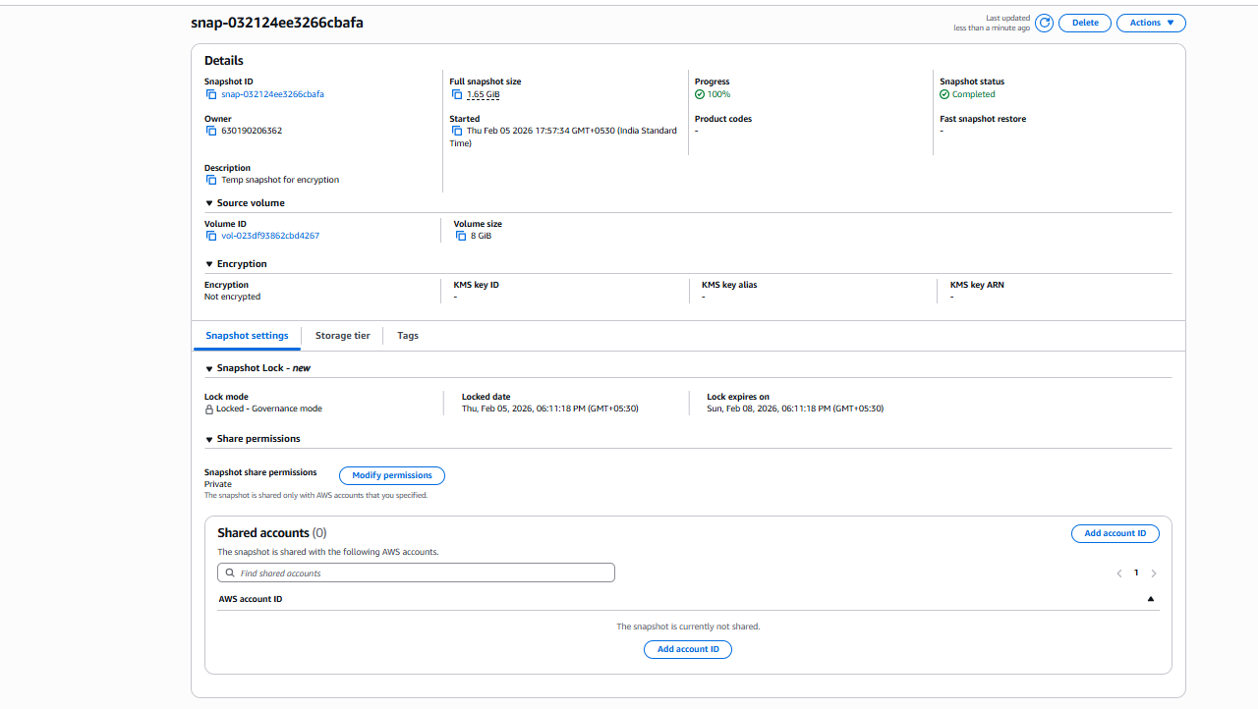
♻ Disaster Recovery Test:
✅ The EBS Snapshot → New Volume → Attach → Mount On Recovery EC2 Screen/Flow

Slide 11
🔁 6. Maintenance & Optimization:
Features: | Security Control:
Snapshot created Snapshot Lock enabled | KMS protected
Encrypted backup flow | Immutable backups
Automatic schedule | Lambda + Event-Bridge
Retention enforced | CloudWatch → Monitoring SNS → Email Alerts
Ransomware proof | Region or instance failure

Slide 12
👉 CONCLUSION:
“I followed the waterfall SDLC model where , i first gathered security and automation requirements, designed a cloud backup architecture, implemented lambda-based encryption automation, tested disaster recovery, deployed monitoring, and maintained cost optimization.”
Features:
- Encrypted snapshots
- Snapshot Lock
- Monitoring & alerts
- Disaster recovery tested
Tech Stack used:
AWS EC2, EBS, Lambda, KMS, CloudWatch, SNS

